Slide 1
Vermicomposting
Alex Slaymaker, Outreach Specialist
Notes:
Thanks for coming!
My name is Alex Slaymaker and I'm SWACO's Outreach Specialist.
I help residents, organizations, and event organizers keep materials out of the landfill.
Previously, I taught sustainability classes and zero waste trainings at ASU, where I earned my masters in sustainability. I’ve worked with cities across the nation on a range of sustainability projects. I’m kind of a nerd.
I'm passionate about composting and I'm so excited to see all of you here today!
This workshop is pretty informal, so if you have a question while I’m talking just please raise your hand and I’m happy to hear it!
[[if a small group, have people say their name and why they came to the session today]] [[provide giveaways: reusable produce bag for answering questions + worm bins]]

Slide 2
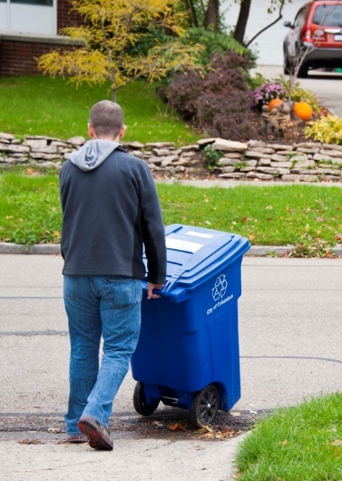
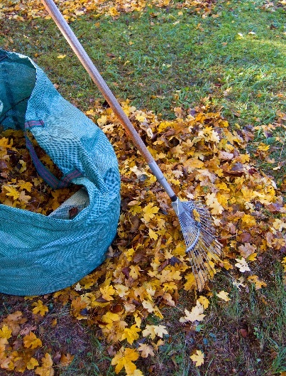
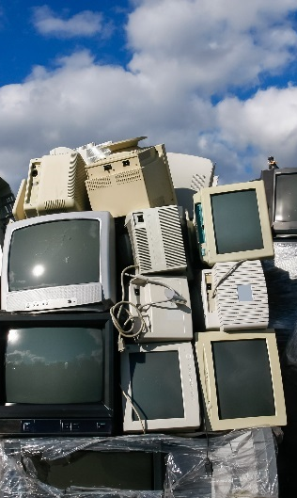
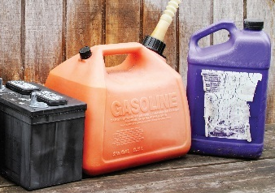
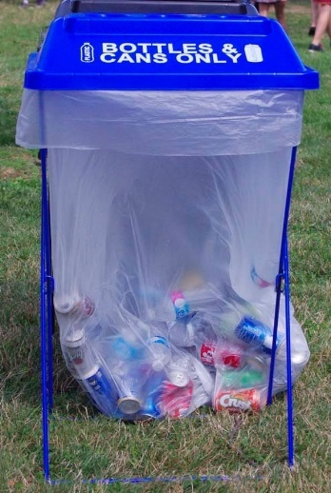
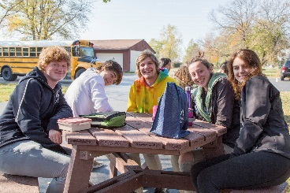
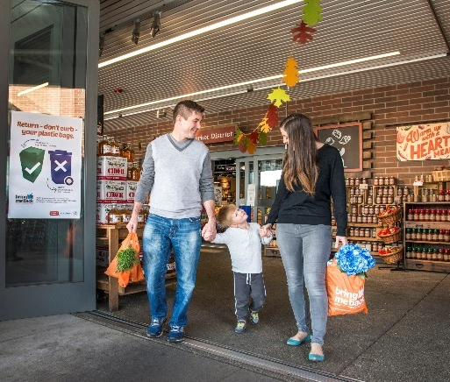
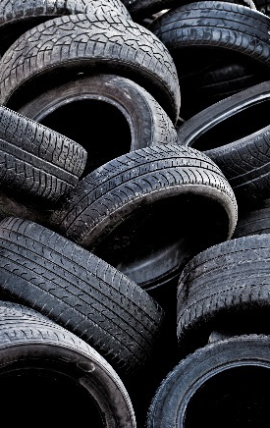

Notes:
Before I dive in, I have a super brief slide describing who SWACO is.
SWACO is a public agency serving all of Franklin County, and we work to position our region as a leader in environmental sustainability by offering a range of waste reduction, recycling and safe disposal services including:
[[click]] The provision of Recycling Education & Recycling Drop-off containers [[click]] along with the Bring Me Back campaign encouraging residents to recycle plastic bags, film, and wrap while utilizing reusable alternatives whenever possible. [[[click]]]
We sponsor free yard waste composting for Franklin County residents [[[click]]]
and collaborate with law enforcement to reduce illegal dumping.
[[[click]]] Our team helps communities recycle electronics and provides free HHW disposal.
We do own and operate the landfill in FC, so we also offer landfill tours. [[[click]]]
Over 2,000 schools kids came through our landfill tour last year. This is a great opportunity to see what happens when we don’t compost or recycle. [[[click]]]
Our team provides recycling technical assistance and infrastructure to event organizers and community organizations trying to reduce how much they landfill.
More info on all of these programs is available on our new snazzy website swaco.org. [[[click]]]

Slide 3
When we waste food,
what else do we waste?
Notes:
Jumping into the content for today, I wanted to start out with a question.
When we waste food, what else do we waste?
Any thoughts on this?

Slide 4
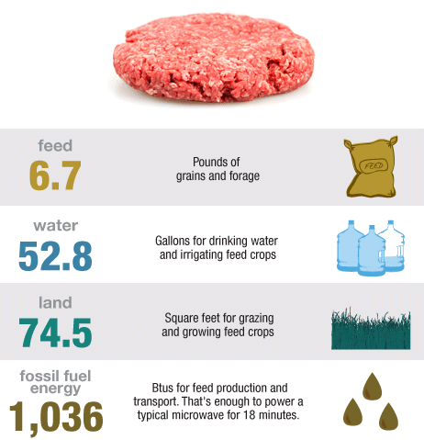
Image Source: NPR
Notes:
When we waste food, we waste all the resources it took to create that food item too.
To get one ¼ lb hamburger to your plate it requires all of these resources. So, if that burger rots and no one eats it, all of these resources are wasted- feed, water, energy….
I’ll give you a second to let these stats sink in.

Slide 5
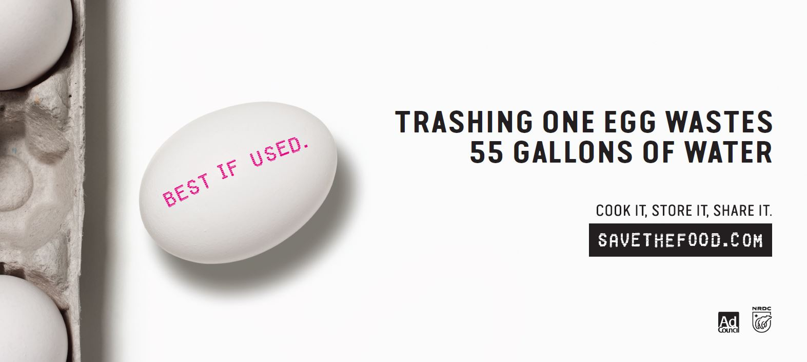
Notes:
Here is one more example to think about….wasting one egg wastes 55 gallons of water. This is information you can’t un-see.
The reason I’m sharing this info is because, from a sustainability perspective, food waste prevention should always be the first step before considering composting.

Slide 6
13% Wasted Food
Notes:
I’m sure you’ve heard mind-blowing stats about food waste nationwide, but how about in our County?
13% of landfilled material in the FCSL is food, which is why prevention is so important.
Anything else surprise you on this slide?

Slide 7
Every time you eat, you make a choice….
Notes:
But, the exciting part is… Every time you eat, prep, or buy food- you have an opportunity to reduce waste!
There are a few tips and tricks you can use to help you responsibly manage food resources.

Slide 8
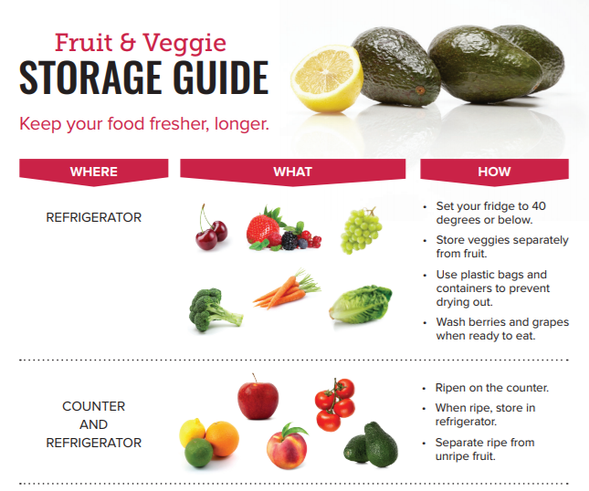
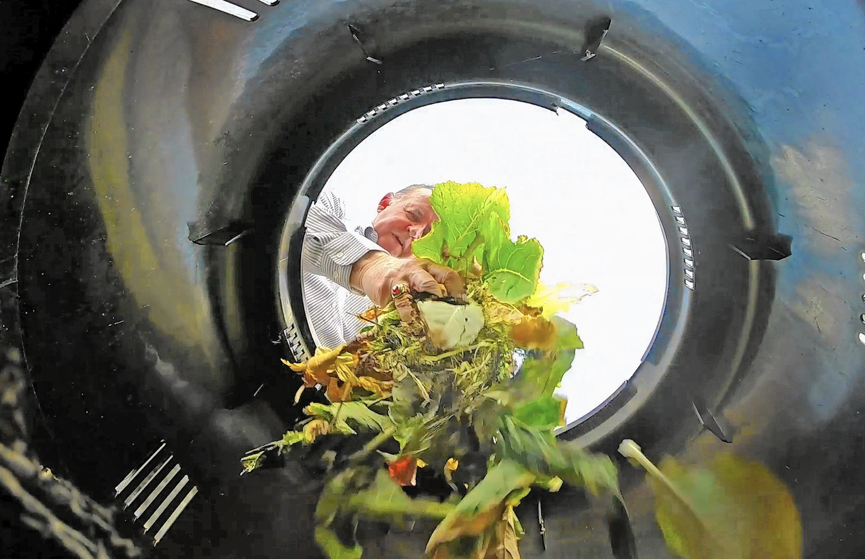

Prevention Tips
What’s in your bin?
Shop Smart
Kitchen hacks
Share or Donate
www.swaco.org
Notes:
More tips are listed on our website under food waste, but I wanted to share a few really important strategies.
The most important first step is to audit Yourself: Look in your landfill or compost bin when you go to toss and consider how waste could be avoided. For example, if you are consistently landfilling wilted basil, consider buying less or learning how to make pesto!
[[click]] After you audit your bin you can make some changes and commitments.
Consider starting with shopping smart: Plan your meals. Make a grocery list based on what you have, and purchase produce that doesn’t look perfect.
[[click]] Learn how to properly store produce for longer life with this simple tip sheet from stopfoodwaste.org. We also have copies on your table in back if you want one. [[click]]
It’s also important to keep track of what needs consumed first to reduce waste. Consider making a sign and designating a part of your fridge for this!
Check out our website for more info or hacks for getting the most out of your grocery bill and minimizing waste.
Also consider how to donate and share your leftover food.
EXAMPLES of using food is questions arise:
Add wilted veggies to crock-pot soup or stew, or a frittata or quiche.
Add bruised or over-ripe fruit like bananas, mangoes, or strawberries to a sweet bread or a compote for pancakes.
Hard breads can be pan-fried and transformed into croutons for soup or salad.
Fry or bake sliced broccoli stalks and pair with a dipping sauce for a crunchy snack.
Use beet greens in your soup or casseroles for added nutrition!
Use veggie and meat scraps to make homemade stock.
To test if ‘expired’ eggs are still good, put them in a bowl of water. If the eggs sink, they're still good to eat. But if they float, they're not good to eat.
Pickle your fruits and veggies for increased preservation.
Where can I donate edible food?
Donations of food are accepted from grocers, food distributors, farmers, and community members assist families in Central Ohio. You can help by donating nonperishable foods and fresh produce at your local food bank including the Mid-Ohio Foodbank. In 2015, the Mid-Ohio Foodbank distributed over 26 million pounds of fresh fruits and vegetables to families in need.
If you’re a restaurant, grocer or other food provider, also explore donating surplus food to Food Rescue or another non-profit.
Donations in good faith are protected from liability under the Federal Good Samaritan Food Donation Act.

Slide 9
An ounce of prevention is worth a pound of compost.
Notes:
What struggles have you faced at preventing food waste? Do you have any other hacks that help at home?
Now that you have some tools and tricks to help you reduce food waste, let’s talk about what to do with all those food scraps you can’t avoid. Let’s talk about composting.

Slide 10
Compost curious?
Notes:
I want to survey the room real fast to see where everyone is at with their starting knowledge. Raise your hand if you would say you are compost curious but not necessarily an expert?
Perfect, so we are going to start off with a high level overview of composting and then we will focus in on composting with worms. Sound good?

Slide 11
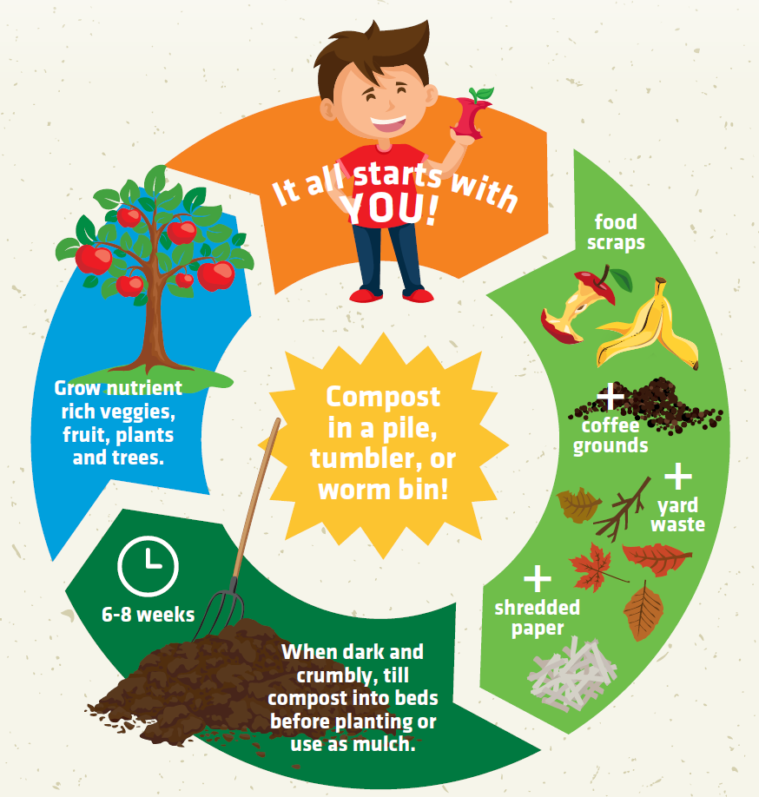
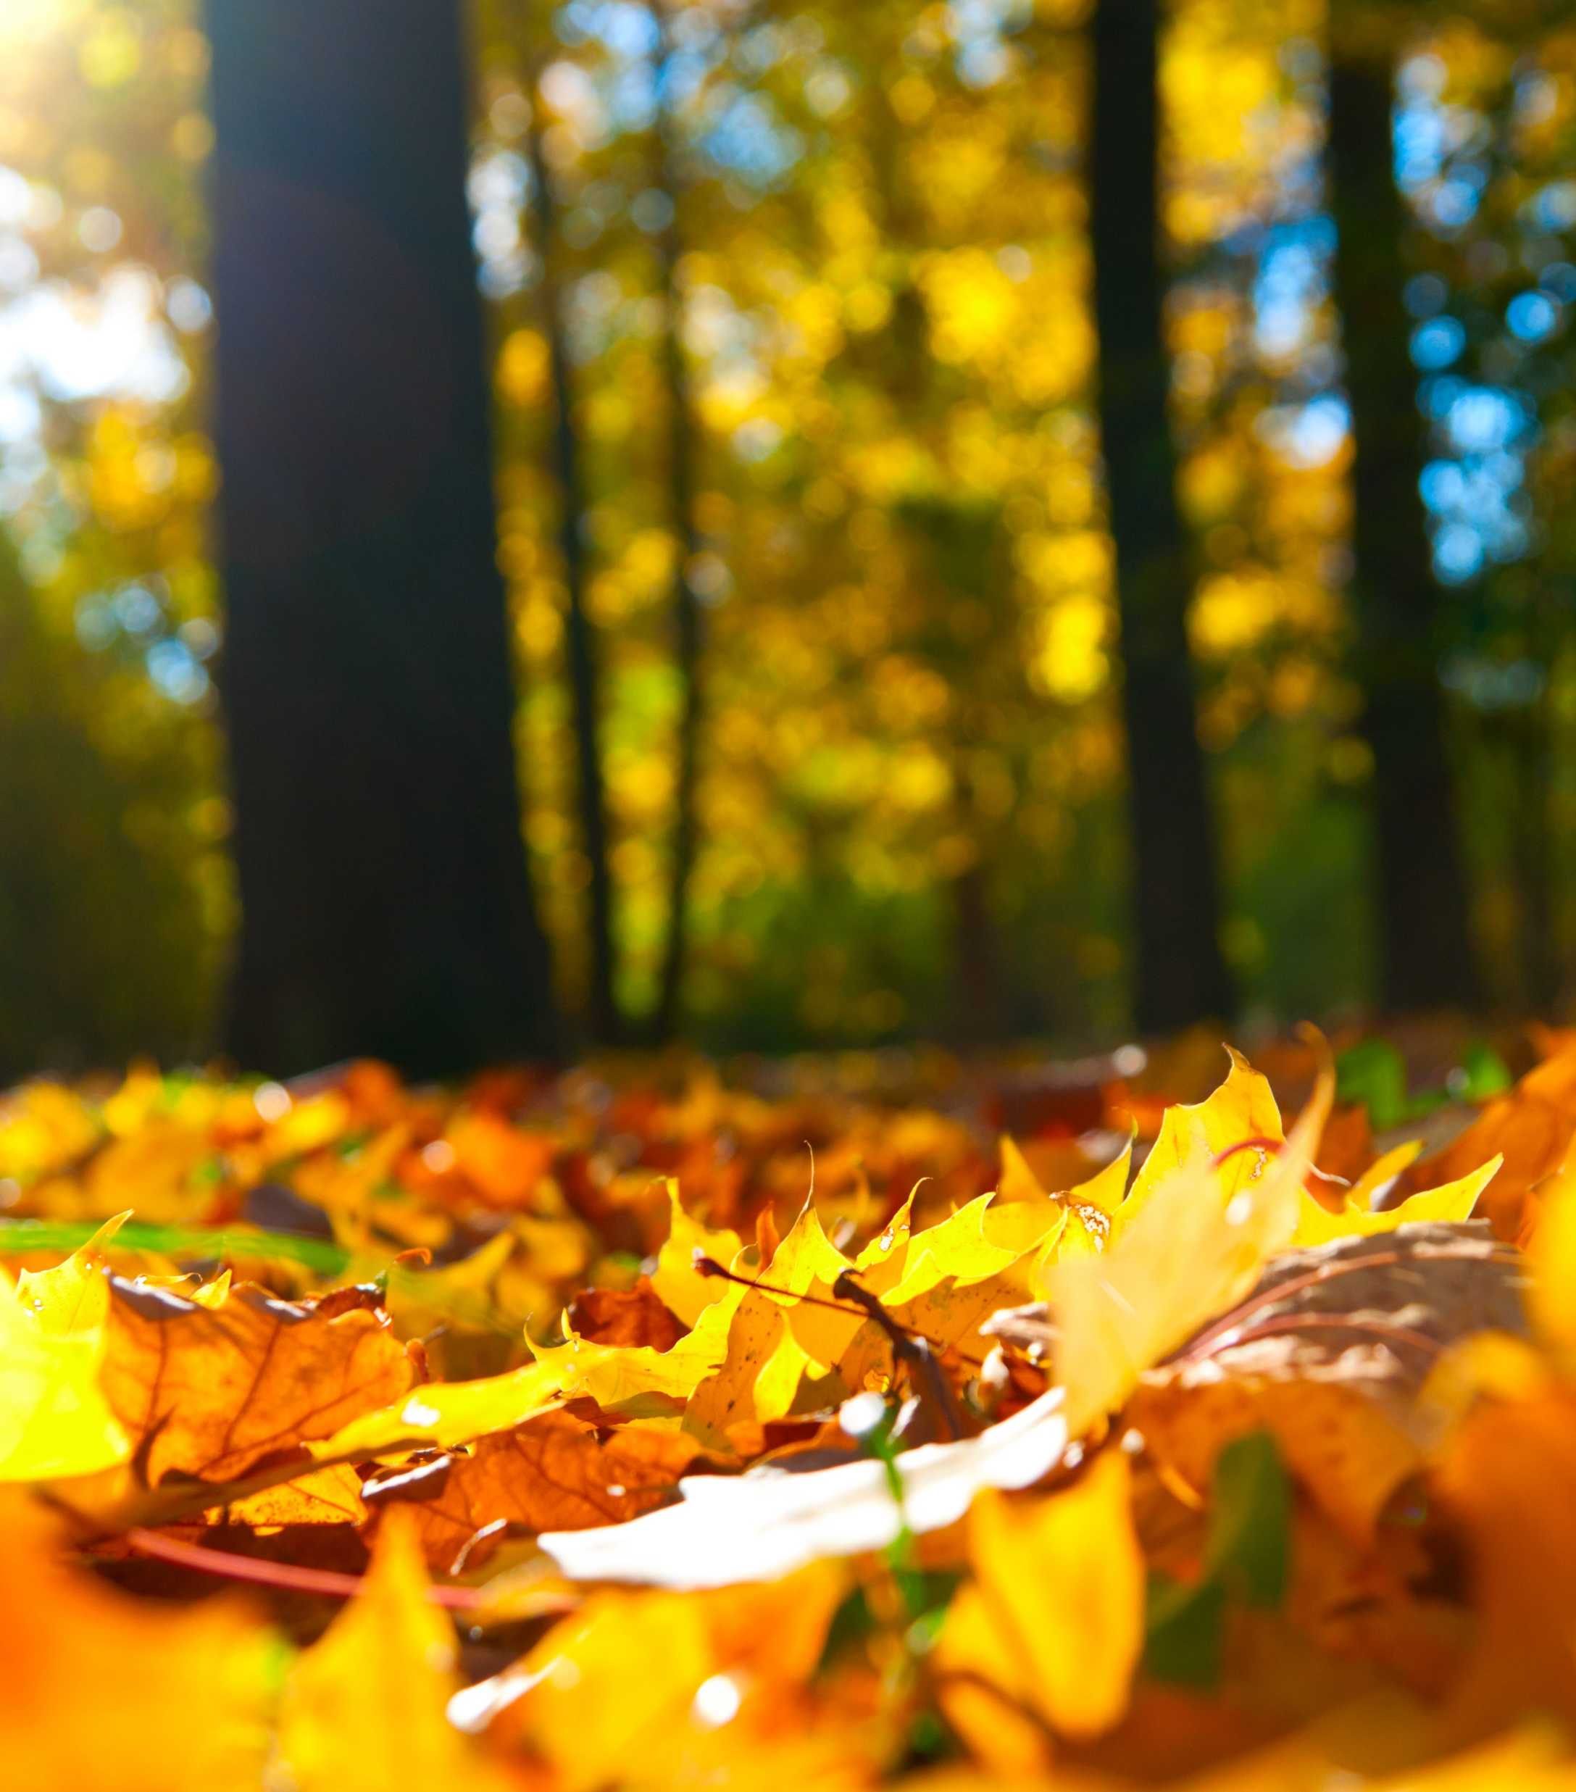
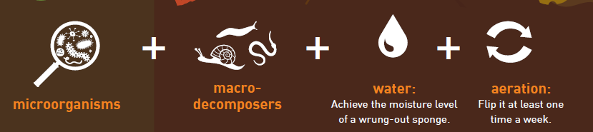
What is Composting?
Notes:
When a tree drops a leaf on the forest floor, its’ not there a few weeks later. This is because the leaf naturally decomposes back into the soil, adding nutrients back to the forest. This closed loop system is how nature was designed to cycle nutrients. Us humans got a little detached from this closed loop system but we are starting to realize we are wasting valuable resources by landfilling food scraps and yard waste.
Compost systems mimic this natural ecosystem of micro-organisms, decomposers, water, and aeration to break your food and yard scraps down into a nutrient-rich additive for your soil.- turning waste to resource. Good ventilation is essential for aerobic decomposition and a healthy environment for worms. [[click]]
composting, is the breakdown of organic materials into a soil amendment. Compost is a nutrient-rich, micro-organism filled probiotic for your soil. These microbes do many things including help plants to become more disease resistant. Just like when you take a probiotic it helps you build up your immune system.

Slide 12
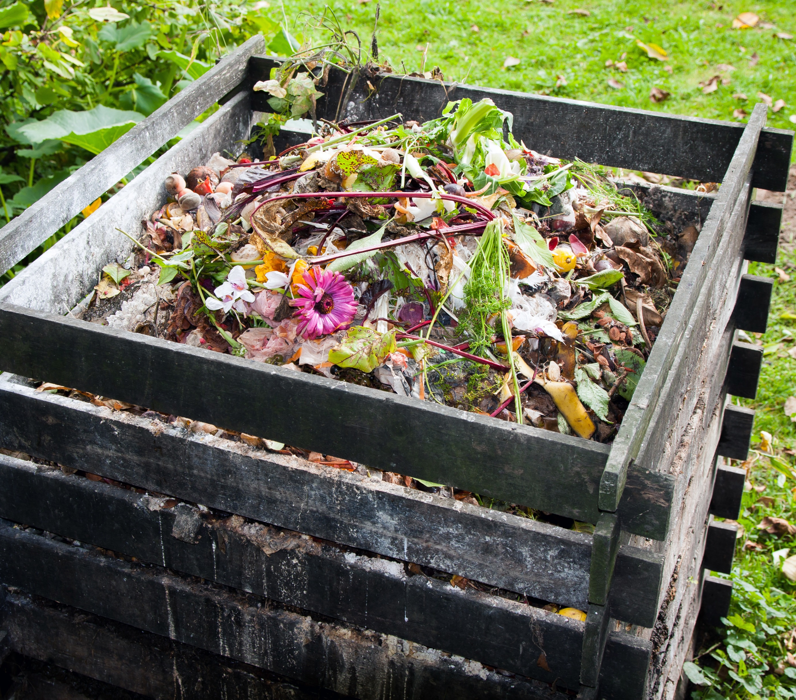
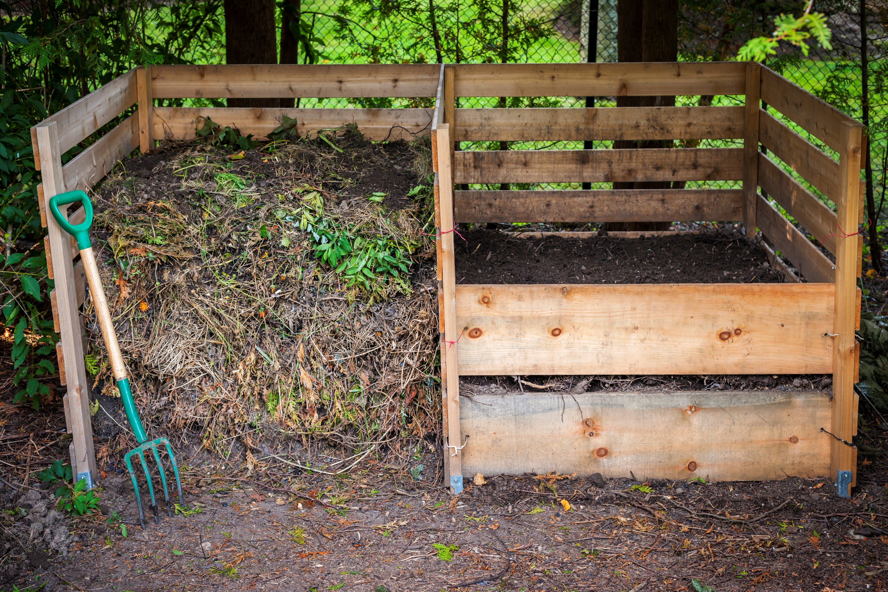
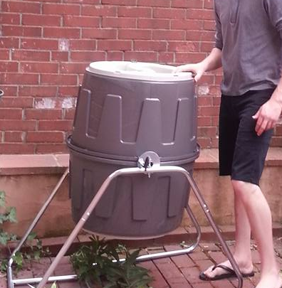
Outdoor Options: Buy or DIY
See Composting Infographic
Notes:
Check out your composting infographic at this time, which outlines different types of composting and some benefits at a high-level. Let’s start with your outdoor options. You could make one pile, two piles so you rotate, or a closed tumbler.
You would typically use a pile if you had outdoor space and a tumbler for patios or if you want an enclosed system due to concerns of attracting critters or attention from your neighbors.
Outdoor options typically do break down materials very slowly during the winter. So keep this in mind.

Slide 13
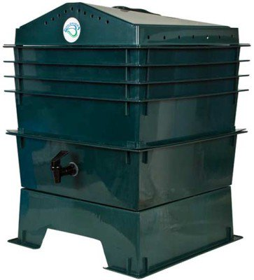
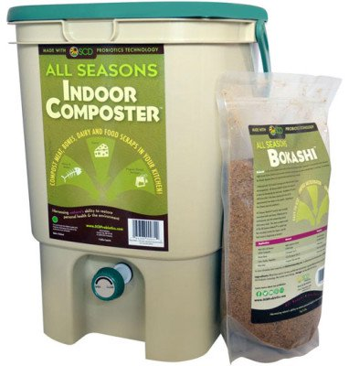
No patio or yard, but you want to compost?
indoors
Your thoughts on worms?
Ehhh…
winter-proof
Notes:
If you don’t have a yard or patio, or just want an enclosed and winter-proof system, you will need to compost inside.
Does this entail setting up a giant pile of compost in your garage? Noo. You have other options .
First question you need to ask yourself, is what are your thoughts on worms? [[click]]
If you immediately cringe at the thought of handling worms, there is another indoor option.
raise your hand if you’ve heard of bokashi
So I’m not going to go into this in detail during this workshop, but I assure you the internet has a lot of content on this. Bokashi composting is an anaerobic process that relies on inoculated bran to ferment kitchen waste, including meat and dairy, into a safe soil builder and nutrient-rich tea for your plants. [[click]]
But if you are like me and love the idea of using worms to transform your food scraps into soil additive, vermicomposting is perfect for you!
Another added benefit is- inside systems are 100% winter-proof, unlike your tumbler or pile out back.

Slide 14
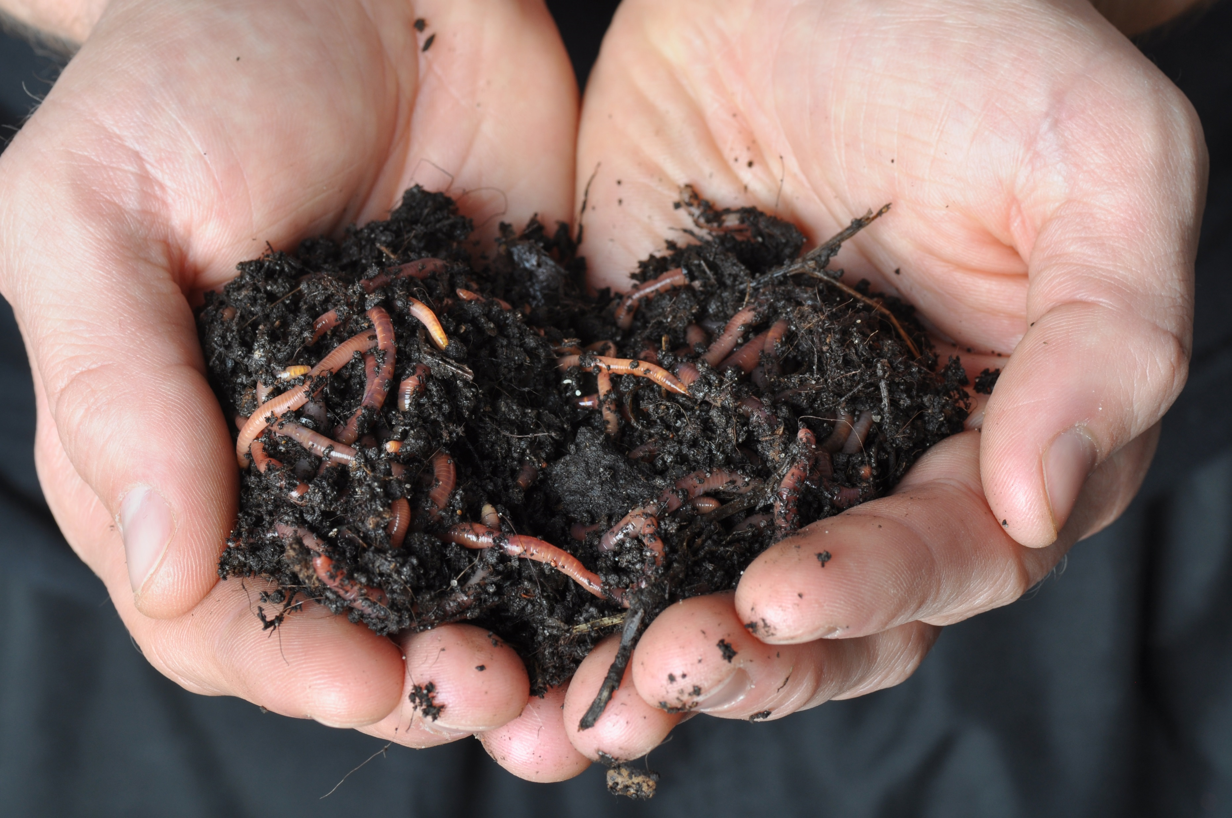
Vermicomposting: using the efficiency of worms to turn food scraps into rich soil additive
Notes:
So what’s the deal with these worms?
Vermicomposting is the amazing transformation that happens when worms and microorganisms turn ordinary food scraps like banana peels into this rich compost for your garden.
This compost is made from vermicastings, the more PC word for worm poop.
So as a vermicomposter, your job is to make a comfortable home for them so they can eat, poop and reproduce

Slide 15
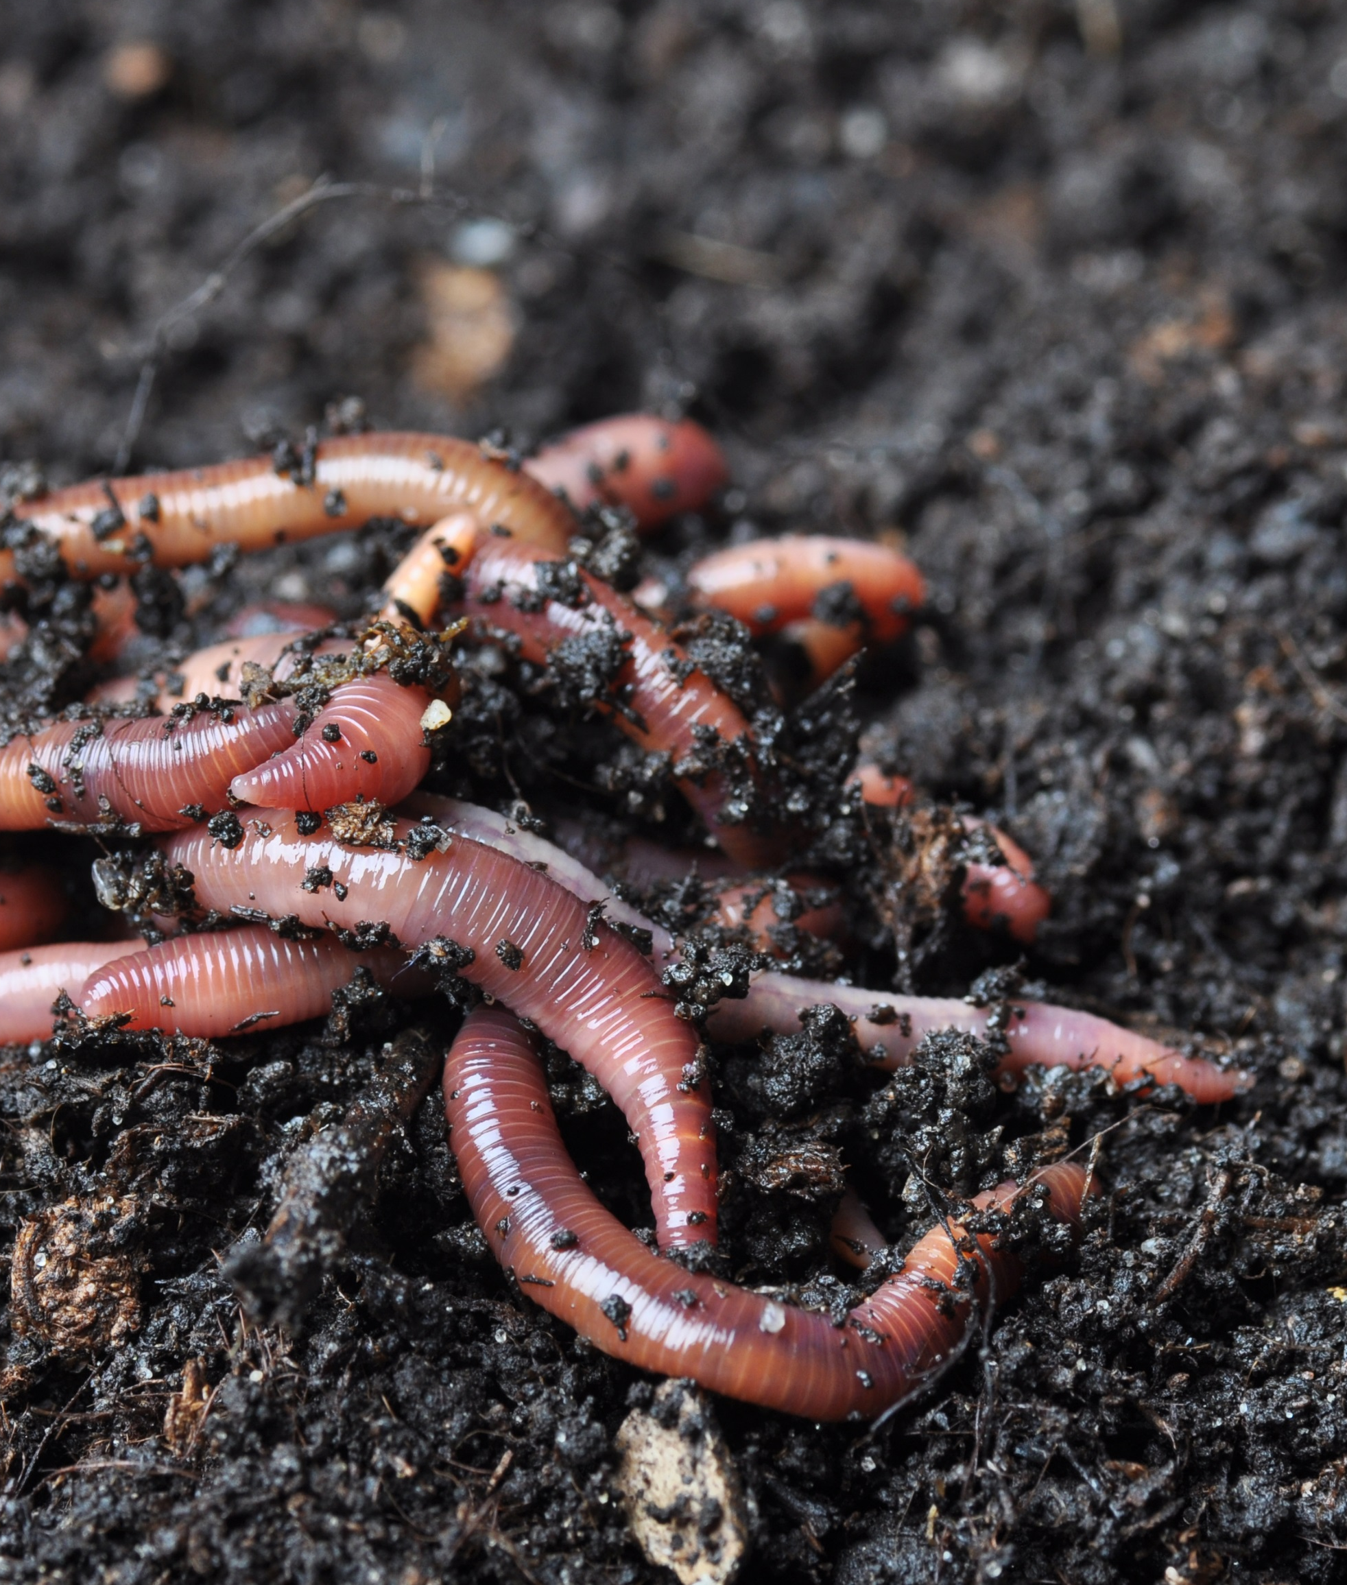
Intro to Worm Parenthood
  Red Wrigglers = MVP
  No thermostat wars
  Wet the skin to let oxygen in
  3.5 lbs food: 1 lb worms/week
  Freeze scraps to keep smells under wraps
??
Notes:
Although there are over 7,000 types of worms, You will want to get red wrigglers also known as red worms (Eisena foetida) for your composting system
because they are the most adaptable and efficient for vermicomposting. Worms are really important and really cool. In ancient Egypt under Cleopatra’s rule, it is reported that anyone who knowingly killed a worm would be sentenced to death.
You can order these online straight to your doorstep. Start with 1 lb (~1,000 worms) of worms for a standard vermicomposting set-up.
You can order worms from Buckeye Organics in Newark Uncle Jim’s worm farm online for example. $30-40
[[click]]
Maybe you have disagreements in your home about where the thermostat should be set? Well, unlike your room mates or significant others, Worms are easy house guests,
they like the same temperatures you do- their ideal temp range is 55 to 80 degrees. [[click]]
you need to keep the bin moist because worms breathe through their skin. Too much water will drown them but too little will dry them out and they can’t breathe. Shouldn’t be dripping. [[click]]
Now I have a quick trivia question-
How many lbs of food can 1lb of worms eat a week? **************PRIZE***************
1 lb of worms can eat 3.5 lbs of food scraps a week
Feeding them once a week is a good routine to get into
Personally, I store food scraps in a container in my freezer, then thaw them out and fee my worms once a week. [[click]]
This isn’t like Airbnb where you don’t know what your guests think about your home until they leave,
Your worms will let you know if you aren’t being a good host-
for example if you leave them out in the sun and they will crawl out
Extra info: Muscle + hair to get from here to there

Slide 16
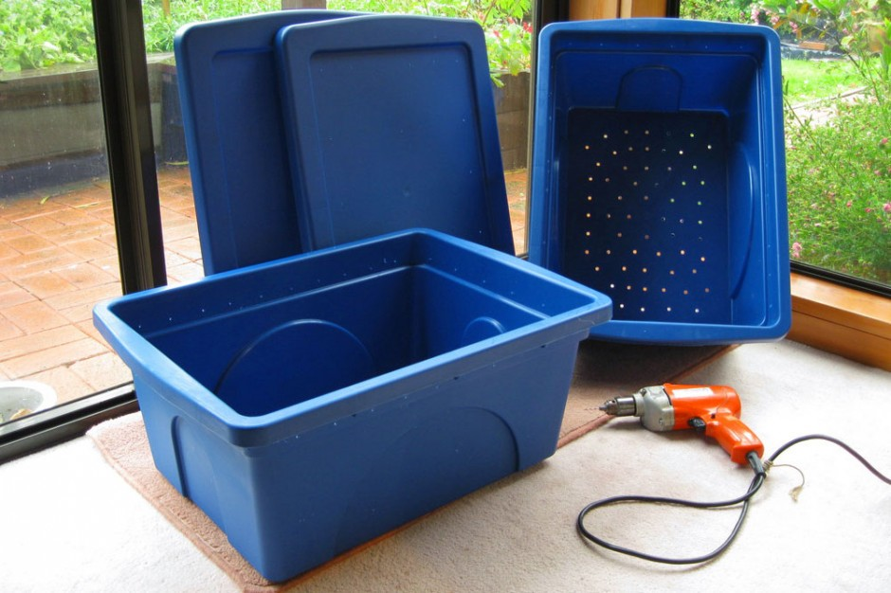
Let’s Talk Real Estate…
Photo Left: Tim Musson (Flickr)
Photo Right: Worm Factory® 360
Notes:
[[PUT TOGETHER THE BINS. MAKE IT A RACE TO SEE WHICH TABLE PUTS IT TOGETHER FASTERS.]]
Now that you know a little about worms, let’s talk real estate.
Options vary depending on the desired complexity, cost, look, and function.
The option on your left is a DIY bin where 2 bins stack and the compost tea is captured separately in the bottom container. DIY takes longer but saves you money.
Then you have the worm factory 360 on the right which is a stacked approach where each tray either has food scraps or bedding and they are layered. This is easier for harvesting.
Lastly, my bin doesn’t capture the compost tea separately nor does it have built in tray but it is aerated and works just fine for my needs.
Bins can be located anywhere from under the kitchen sink to outside or in your garage. Where ever you locate it, consider temperature.
Ideally a worm compost bin should be located in areas where the temperatures are between 55 to 80˚F.
Do you notice any similar characteristics between these different types of bins? Yes- opaque (worms don’t like light), ventilation

Slide 17
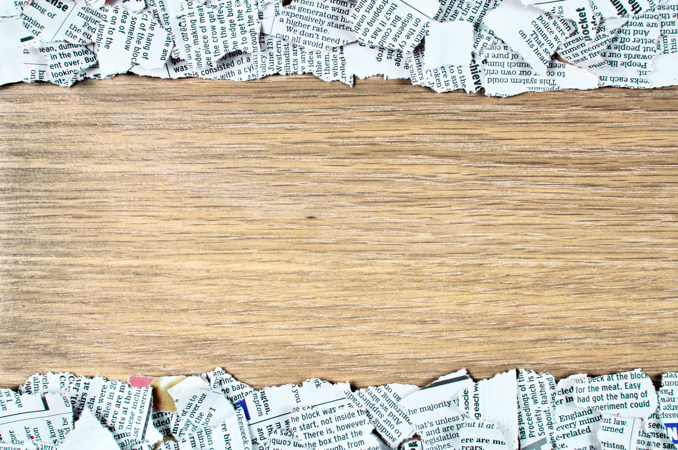

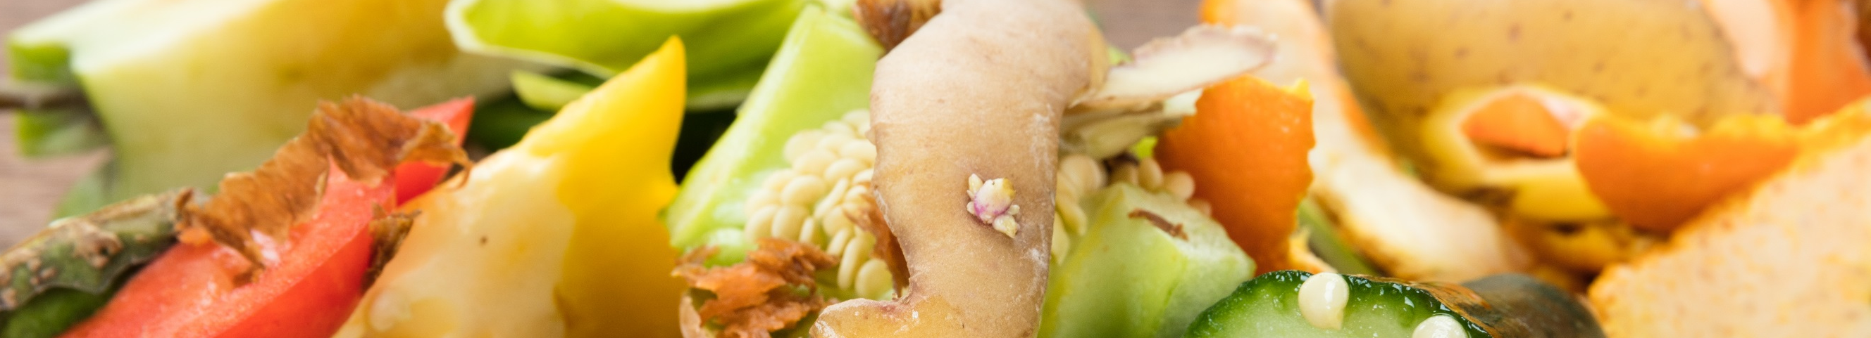


There’s No Place like Home!
Start with bedding
Add worms
Adjustment: 1 week
Layer
Notes:
[[GO THROUGH PROCESS OF ACTUALLY MAKING BEDDING. HAVE A COMPETITION. WHICHEVER TABLE TEARS UP A WHOLE NEWSPAPER FASTER WINS A BIN EACH.]]
So how do you make a worm home fit for worm royalty? I’m going to share the process with you, then each table is going to assemble a bin.
First, you’ll need bedding that will fill the bin from one-third to one-half full.
To create bedding soak ripped up newspapers or cardboard. Worms want an environment that is about 75 percent water.
Newspapers should only take a few minutes to take up enough water to make proper bedding.
Allow cardboard, such as toilet paper rolls and tissue boxes, to soak overnight.
Bedding should be wrung out. You don't want it dripping wet, but like a moist sponge.
Once the bedding material has been soaked, wring it out until it is moist, but not dripping.
Place it in the bin along with something gritty such as a bit of soil, fine sand, leaves, cornstarch, sawdust or ground egg shells. (Worms don’t have teeth so they need something gritty to help them grind up the paper and food.) Once your bin is up and running it will be self-sufficient and you won’t need to add additional grit until you harvest the worm castings and clean the bin. Don’t use manure because it emits gases, may carry pathogens.
To make your worms feel at home, dig down until about the middle of the bedding and place your worms there. Don’t just put them on top.
Then place the lid on the bin and keep it at a moderate temperature. Leave them alone for about a week to settle in. They will feed off the bedding.
After about a week, start feeding your worms food scraps. Every week when you add your scraps, add a layer of browns or newspapers on top. It’s like worm lasagna.
Layering with brown is super important to keep odors down!

Slide 18
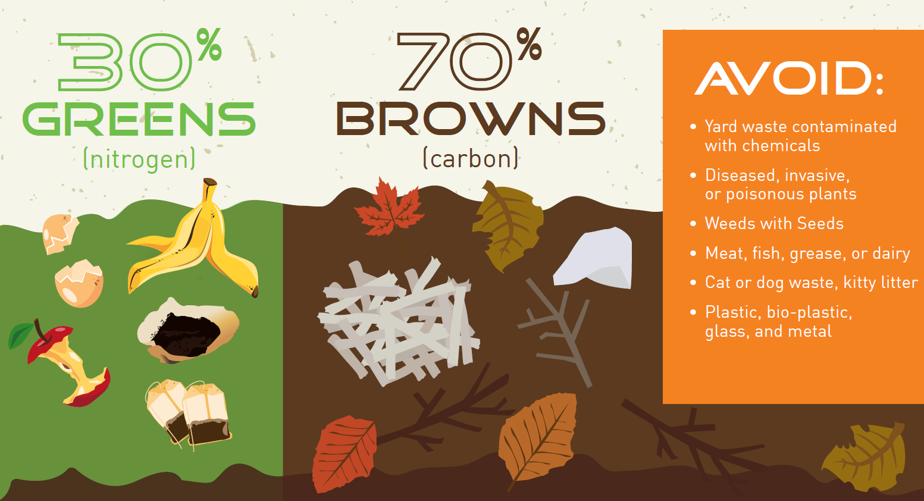
Notes:
Let’s talk a little more about what goes into the bin. Covering up our nitrogen rich items like food scraps with the dried out organic matter like dead leaves helps keep the chemistry aligned for fast, smell-free decomposition. Another way to think about the greens and the browns are to consider what is and is not burnable- the browns are easily burnable while the greens aren’t typically.
Make sure you don’t poison your worms by accidentally adding dangerous chemicals. We suggest not adding plants you don’t want to repopulate in your yard because you may end up spreading the seeds when you use your compost.

Slide 19
What’s on the Menu?
Yes! |  | No Thanks…
Leafy Greens & Veggies |  | Garlic & Onions
Fruits |  | Citrus
Grounds, Filters, & Bags |  | Processed & Sugary Food
Brown paper & Newspaper |  | Bread
Crushed Eggshells |  | Meat or Dairy
Notes:
In terms of diet, view your worms as health nut vegans.
They don’t like processed foods, meat, or dairy. So, this may be the only tricky part for some families who eat meat or dairy. These goods are pretty expensive though so hopefully there isn’t any waste from this food type to begin with.
Most of the items on the do-not-eat list are there due to flies, odors, or the majority of worms just not liking the food.
You can always experiment by adding someone and seeing how they respond. But, be ready for the consequences.

Slide 20
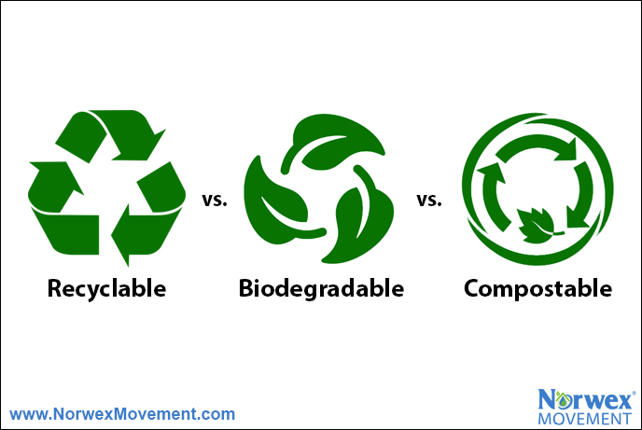
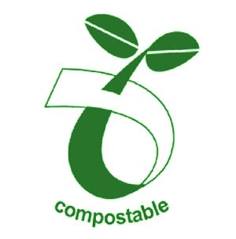
What’s the Difference?
Biodegradable
Compostable
vs.
Notes:
So you may be wondering, what about paper plates and bioplastics? Can you put those in your vermicompost bin or any composting bin in your home?
The biodegradable symbol can be misleading because this just means the product will decompose eventually, but it could take 10 years.
While compostable means the product should decompose in less than 60 days under the right circumstances.
If you have to buy plates, purchase 100% BPI certified compostable plates that have no bioplastics in them. These you could soak overnight, rip up, and feed to your worms.
Beware of greenwashing. Just because it’s brown and has a leaf on it, doesn’t mean it’s compostable.

Slide 21
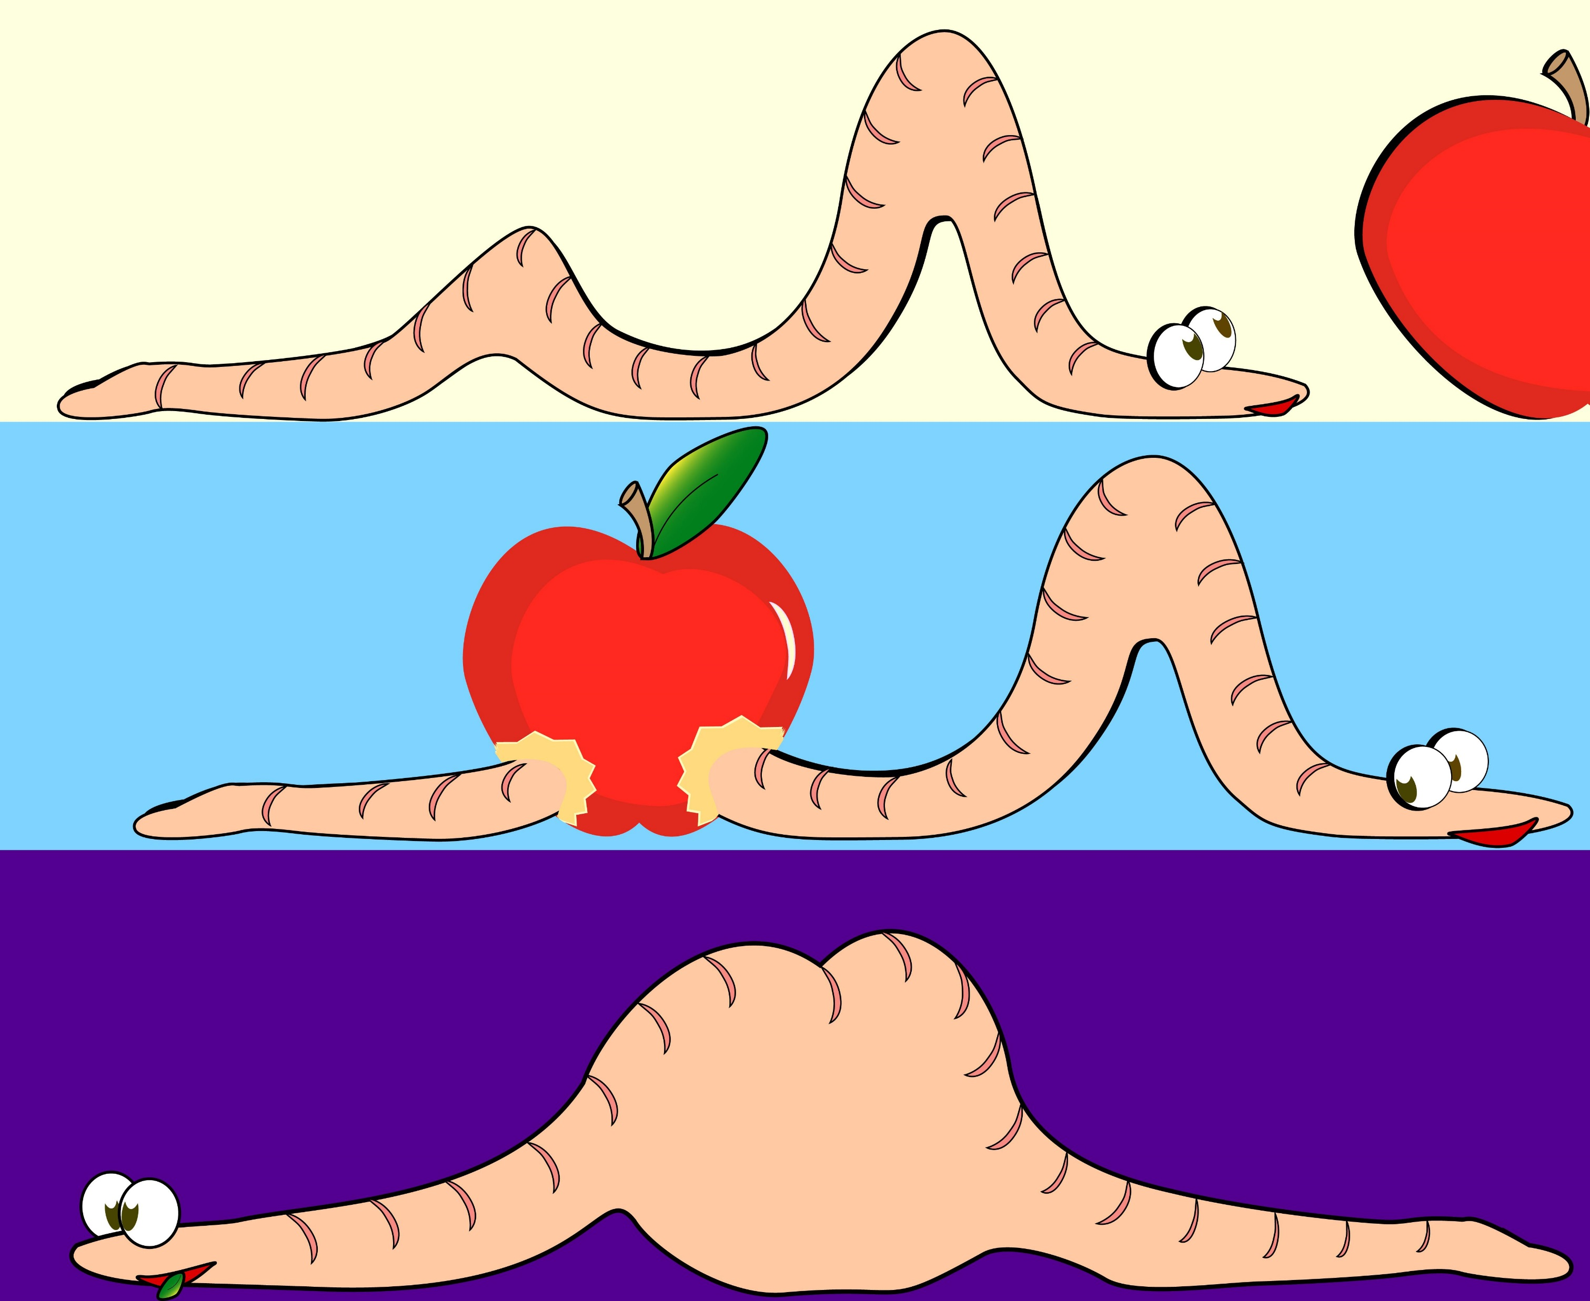
Bite-Size Portions
Go Down Easier!
Notes:
Just like you cut up food for your kids, your worms will eat small bits of apple faster than a whole rotted apple.
Some people even toss their scraps into a blender!

Slide 22
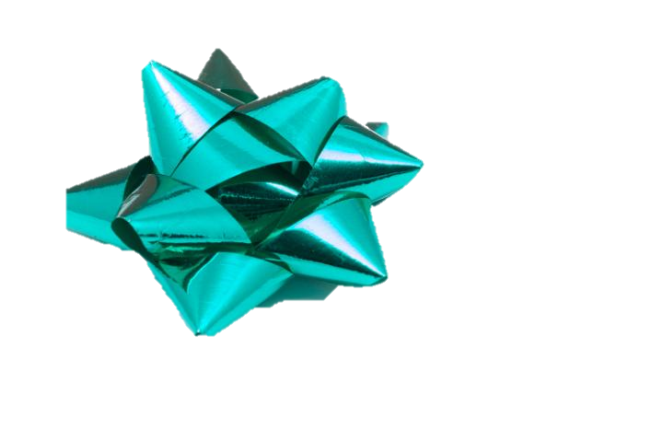

A Different Kind of Harvest
2.5 – 6 months
Test it
Tarp it or Half it
New bedding
Share
Notes:
Castings can be harvested anywhere from two and a half months to every six months,
depending on how many worms you have and how much food you’re giving them.
So, How do you know when it’s ready?
[[click]] There is a simple test you can do. Any guesses as to what you can do to test it?
Put a cup of the compost into a container and seal it. Leave it in a drawer for a few days and when you take it out and open it, the material should smell the same as it did before or it’s not done decomposing.
When it passes the smell test- if you have a stacked system with multiple trays, you just harvest the tray full of compost.
There are several harvesting methods you can use for a bin like I have or you saw in the DIY photo.
[[click]]For those with the time and patience or little kids, you dump the bin’s contents onto a plastic tarp and then manually separate the worms from the compost. Children usually love helping out with this process.
A more common way and less intensive way to harvest is to move everything – worms, castings, bedding, food – to one side of the bin. Pick out partially decomposed materials and push to the other side. Place some food on top of the partially decomposed materials. Replace the lid and leave it alone for a couple weeks. During that time, the worms should migrate over to the new food. Once they’ve gone to the other side, put on a pair of gloves and harvest the castings.
[[click]] No matter what method you choose, remember to wear gloves so you don’t accidentally conduct biowarfare on your worms by introducing pathogens. For both options, give the worms new bedding mixed in with some residual compost, because the residual will be rich with microbes.
If your worms are happy in their homes, they will reproduce. In fact, a 3 mo old wriggler lays 2-3 cocoons a week and each cocoon only takes 11 weeks to hatch. So in a few months you are going to have a large increase in your worm population! Share your worms with friends and help them start their own vermicomposting system! What a great birthday present that would be, a box full of worms!

Slide 23
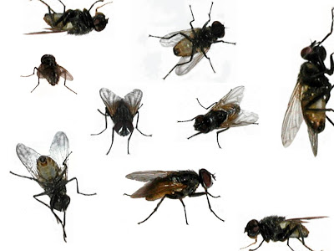

Troubleshooting
Smelly?
Flies?
Stick to the diet
Moisture levels
Ventilate
Add bedding
Stick to the diet
Bury with brown
Notes:
When you compost, you are managing an ecosystem. Just like with our planet, if different factors aren’t kept in balance then issues start to arise.
[[click]]
If your bin is smelly there may be a few drivers. Compost actually doesn’t smell. Double check if you are feeding your worms the right things, finding the goldilocks spot with moisture, and ventilating. Also, you may just need to add more carbon materials or bedding on top.
Remember- “BURY WITH BROWN TO KEEP ODOR DOWN”
[[click]]
Flies are the other common consequence of a mismanaged system. Make sure you stick to the diet and bury their food with newspaper and other carbon materials. [[click]]
If you ever are experiencing issues with your bin and aren’t sure how to react- Google is your best friend. There are tons of resources online.

Slide 24
Your opportunity to make a measurable difference
Notes:
Hopefully these food waste prevention and composting tips have inspired you.
You are all in an important position to make a measurable difference and help lead our community towards a more sustainable future.

Slide 25


Questions?
“It may be doubted whether there are many other animals which have played so important a part in the history of the world, as have these lowly organized creatures.”
- Charles Darwin 1881
@SWACOGreen /SWACO.org alex.slaymaker@swaco.org
Notes:
Thanks for your time and I’d love to answer any questions you have.
Ask questions of content covered to each table-first person to answer wins the table’s container!

Slide 26
Trivia!
How many hearts?
How many bones?
How many lungs?
1 way to reduce food waste?
% landfilled food?
Are dried leaves C or N?
Why is bin moisture important?
1 solution for a smelly bin?
What temp range do worms like?
# worm species?
Notes:
[[HAVE TICKETS OR SOMETHING TO GIVE TO THE WINNERS SO IT’S EASY TO KEEP TRACK OF WHO GETS ONE/ WHEN THINGS RUN OUT]]
Five hearts
No bones, use muscles and hairs to move.
No lungs, breathe through skin. Need to be kept moist.
Do earthworms have eyes?
No, instead they have receptor cells that are sensitive to light and touch. These cells allow earthworms to detect different intensities of light and to feel vibrations. They will move away from light, if they can. If earthworms are exposed to light for too long (about an hour), they will become paralyzed and die when their skin dries out.
Can earthworms smell?
Instead of noses, earthworms have chemoreceptors in the anterior region that react to chemicals.
How do earthworms breathe?
They do not have lungs; instead, they breathe through their skin. Their skin needs to stay moist to allow the passage of dissolved oxygen into their bloodstream. They coat their skin with mucus and need to live in a humid, moist environment.
How do earthworms move?
They have groups of bristles (called setae) on each segment that move in and out to grip surfaces as the earthworms stretch and contract their muscles to push themselves forward or backward.
If I cut an earthworm in half, will it regenerate into two earthworms?
No. The half with the earthworm’s head can grow a new tail if the cut is after the segments containing vital organs. But the other half of the earthworm cannot grow a new head (and all of the other organs needed to sustain the earthworm).
Which end is the head?
The head is at the end closest to a swollen band encircling the earthworm. Although they can move forward and backward, they tend to move forward most often.
How do earthworms eat?
They have tiny mouths and no teeth, so earthworms eat differently than you and I. An earthworm will push its pharynx (throat) out, grab microorganisms and little bits of organic matter, and pull them into it’s mouth. The food is coated with saliva, pushed down the esophagus into the crop and on to the gizzard, where it is crushed and ground apart. Next, it moves into the intestine, where food is broken down more by digestive enzymes. Some of the food is passed into the bloodstream for use by the earthworm and the rest passes out the anus as castings (worm poop).
What is the swollen band near the head called and what is it for?
It is called a clitellum and it contains eggs and sperm for reproduction.
How do earthworms reproduce?
Earthworms are hermaphrodites, so individuals have both female and male reproductive organs. They mate by joining their clitella and exchanging sperm. Each earthworm will form an egg capsule in its clitellum and pass it into the vermicompost 7 to 10 days later. The egg capsule is golden-brown colored and looks like a tiny lemon the size of a match head. Two to seven Eisenia fetidababies will hatch from an egg capsule in 30 to 75 days.
What is the difference between vermiculture and vermicomposting?
Vermiculture is the process of breeding worms. Growers usually pay for their worm feed, and the worm castings (manure) are often considered a waste product. Vermicomposting is the process of turning organic debris into vermicompost. Operators use a wider variety of feedstocks and make money on tipping fees and sales of vermicompost. The earthworm population usually remains stable.
Aren’t all earthworms the same?
No, there are over 9,000 species of earthworms, ranging in size from half an inch to 22 feet long.
What species of earthworms are used for vermicomposting?
Only seven species have been identified as suitable for vermicomposting. One species, Eisenia fetida, is used by most people throughout the world. Eisenia fetida is commonly called red wiggler, in addition to several other common names.
https://content.ces.ncsu.edu/worms-can-recycle-your-garbage
https://composting.ces.ncsu.edu/vermicomposting-north-carolina/wormy-facts-and-interesting-tidbits/
- WHERE TO BUY: You can order worms here from Buckeye Organics in Newark or other vendors. You are looking for 1 lb. of red wrigglers (~1,000 worms) to start a bin the size I showed you. This will cost $30-$40. Request the worms are held at the local post office to ensure they don’t die in your mailbox.
- REPRODUCTION: A mature red wiggler (3 months old) can produce two to three cocoons per week. Each cocoon averages three hatchlings. Cocoons take up to 11 weeks to mature and hatch. Hatchlings require two to three months before they grow to be mature breeding worms. These averages are impacted by moisture, food availability, and other conditions.
- LIFE SPAN: A worm’s life span depends on many environmental factors. But, most sources believe worms can survive 5 years under excellent conditions. Worms are mostly made of water. When worms die, they dry up and are hardly noticeable in the bin.
http://www.eulesstx.gov/composting/vc_reproduction.htm

Slide 27
